Slide 1
Clubcard
Using Clubcard to say ‘thank you’

Slide 2
Clubcard is our way of saying ‘thank you’ to customers for shopping with Tesco
Clubcard is the biggest loyalty scheme in the world
15 million customers
1 point for every £1 spent in Tesco plus opportunities to earn extra points (double points have been in place since August 2009)
75% of all Tesco sales go through on Clubcard
Points are given back in ‘cash’ vouchers - £530m last year
Plus additional targeted information, coupons and offers
Customers like Clubcard and see it as the best loyalty scheme in the UK
Clubcard is still recognised by customers as ‘the original’ loyalty scheme
Clubcard makes the Tesco brand feel warmer
Clubcard Rewards are the ‘WOW’ factor, offering benefits that are personally rewarding beyond the everyday, functional experience of shopping
Customers are emotionally engaged, it creates excitement, drives their behaviour and brings Clubcard ‘front of mind’
Clubcard is a major differentiator to the Tesco offer vs. the competition

Slide 3
Clubcard is good for Tesco too
Last year Clubcard directly drove £1 billion of sales
Highly engaged Clubcard customers are worth more to Tesco
Loyal Clubcard customers churn and switch less
Customers that are contacted regularly by Clubcard are more loyal
Stores with higher Clubcard penetration have higher sales per square foot
The data from Clubcard is used extensively across the business and indirectly drives additional sales and benefits
Retail Services have found the Clubcard customer base key to low cost acquisition of new customers
Clubcard drives a large revenue stream for Tesco

Slide 4
Clubcard Objectives
Drive long term loyalty
Drive short term sales uplift
This is done by
Contacting more customers more frequently with relevant content and offers
Ensuring customers have strong points earning opportunities
Talking about Clubcard to customers and staff
Engaging Commercial in all of the above

Slide 5
Clubcard uses data to target on a personal level
Coupons are highly targeted based on a range of attributes
For example – shopping habit, lifestage, lifestyle, geographic location
Clubcard has in place various golden rules to protect customers from bombardment and give customers relevant and varied offers
Clubcard activities have some unique benefits
Reward loyalty, with personal offers that are exclusive to particular customers and below the radar – creates a sense of value
Highly targeted, with different offers levels, depending on category and brand engagement or other factors, such as key stores or again key competitors

Slide 6
What objectives do Clubcard activities have?
Reward loyalty
Thank customers
Retain customers
Drive
trade
Increase
depth of
spend
Increase
breadth of
spend
Reactivate
lapsed customers
Encourage product trial or
recruitment
Encourage repeat
purchase

Slide 7
Exercise – Clubcard Objectives Game
Identify the objective of each Clubcard campaign…
A coupon for extra points on a product that a customer already buys
A gift voucher and questionnaire to a customer who has stopped shopping
100k Gillette Mach 3 razors given as a gift to loyal customers
Stretching ‘spend and save’ coupons to customers living near Extras
A Clubcard Bonus coupon for 1000 points when you take out a Tesco credit card
Quorn coupons for Healthy Living Club members who don’t yet buy Quorn
Reward loyalty
Interact with wider brand
Retain
Breadth or depth of spend
Drive trade
Reward Loyalty
Retain
Reward Loyalty
Trade Driving
Interaction with wider brand
Breadth of spend

Slide 8
The Clubcard customer journey
Join
2-3 weeks
3 months
6 months
Ongoing
Clubcard application form with temporary Clubcard
Welcome pack with personalised card & key fobs
Statement
Statement and permission-based opt-in activity
Ongoing contact dependent on opt-ins / loyalty / lifestyle
Customer
Journey
Essential data captured (Data protection).
Information & education
Coupons and Vouchers
Loyalty and Lifestyle determined
Regular contact
dependent on behaviour

Slide 9
The Clubcard team
The Clubcard team is divided into 5 main work streams
Operations
Customer Contact
Communication
Insight
Technology

Slide 10
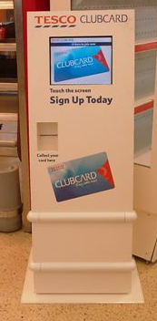
Clubcard Operations
The operational hub ensures that the functional part of Clubcard is delivered for customers and stores
Stores and Staff
Functional engagement of store management teams to improve penetration, stores performance and awareness of Clubcard
Emotional engagement of staff to Clubcard and making staff ambassadors of the scheme
Reviewing operational KPIs and measures in store
Supporting customer managers to deliver relevant communication and training to our staff (as part of the 2010/11 customer plan, Clubcard Champions will be in place in all stores)
Developing technology to make Clubcard more rewarding in store
Welcome process & Card Issuance
Ensuring new customers get their Clubcard
Deliver a better, simpler, cheaper welcome process for new Clubcard customers
Using technology to ensure customer details are captured and cards are
produced in minimal timescales
Coupon operation
Set up and validation of Clubcard coupons
Legal conformance of terms and conditions
Barcode quality checks and system set up to ensure coupons scan at till against qualifying products

Slide 11
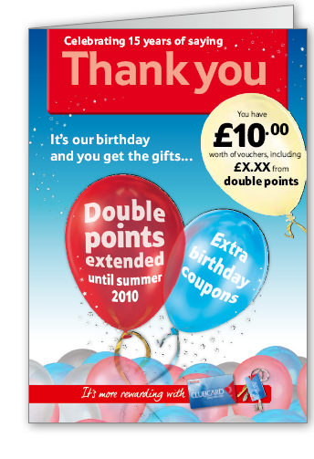
Customer Contact – Core Scheme
The core scheme team manages the Clubcard Statement, points, vouchers and couponing
The Clubcard statement is our way of saying “thank you” to customers
It rewards customer loyalty – we give back over half a billion pounds to customers each year
6 times a year we send over 15m Clubcard holders their Clubcard statement
Clubcard vouchers
Customers earn points which are converted to Clubcard vouchers to use in-store, online, on petrol or on Clubcard rewards
Customers need to collect 100 points to get a voucher in their statement
Clubcard vouchers drive trade
Coupons
Individually targeted coupons – we issue 84 million within each statement
These can be supplier funded or Tesco funded
Each statement we generate £23m in sales uplift from coupons

Slide 12
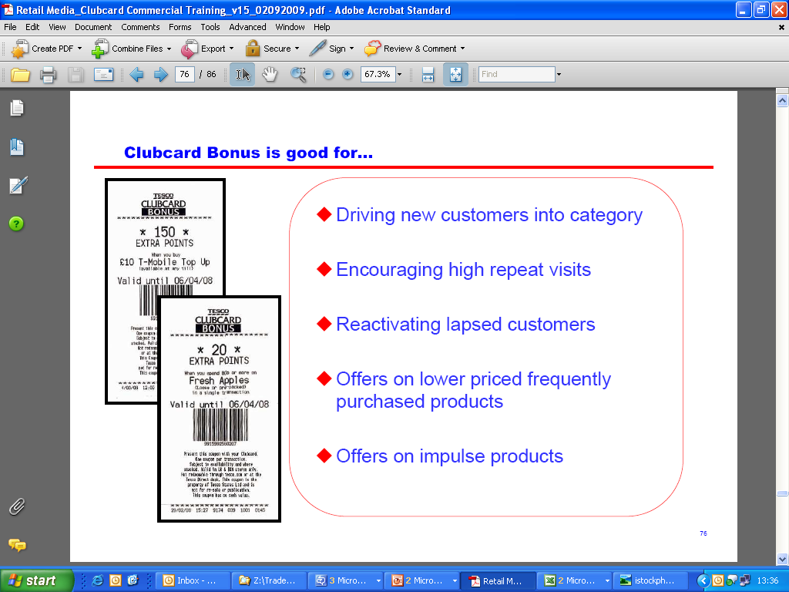
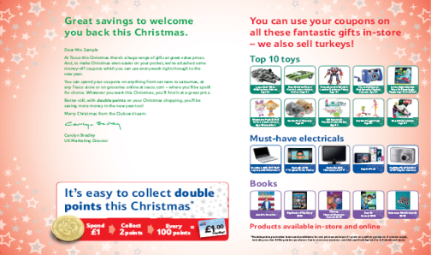
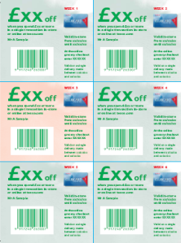

Customer Contact - Clubcard Bonus & Trade Driver Mailings
Clubcard Bonus
Highly targeted coupons issued to customers at till in fortnightly waves
Used to give customers money off, extra points, or free products that they like
Coupon recipients are pre-selected as the most relevant audience
We can issue coupons to 8 million customers over each 2 week period
Bonus has a very short lead time of 6 weeks, and low operational costs
Can be used to drive depth and breadth of shop, encourage repeat visits, drive trade, support category or supplier objectives
Trade Driver Mailings
Trade Driving mailings are sent to less loyal customers to drive short term trade
These time banded, spend and save coupons give us an SCR of around 5.5:1
Clubcard Bonus can be used to prolong the campaigns or drive extra trade if required

Slide 13


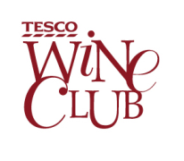

Customer Contact - Clubcard Clubs
There are 5 Clubcard Clubs – customers choose, or ‘opt in’ to receive these mailings
Clubs were set up with a primary objective to reward and thank loyal customers, however they now also act as a mechanic to drive trade
Food Club
Food Club is mailed 5 times a year with targeted coupons to 600k mid-upmarket customers who love food and have an aspiration to become a better cook.
Results: SCR: £3.5 : £1. Redemption: 29%. Participation: 46%. Uplift: £4.9m. Value of Club: £34m.
Healthy Living Club
Healthy Living Club is a segmented model where families and non-families are sent tailored content and targeted coupons 5 times a year. There are 500k members who want to make healthy choices, seek inspiration and advice.
Results: SCR: £2.8 : £1. Redemption: 35%. Participation: 51%. Uplift: £8.0m. Value of Club: £15.3m.
Wine Club
Wine Club currently sends 4 targeted mailings a year plus 4 additional category mailings. The club has 405k members who have an interest in wine.
Results: SCR: £1: £1. Redemption: 29%. Participation: 35%. Uplift: £10.6m. Value of Club: £22.8m.
Greener Living
Website (www.tesco.com/greenerliving) and monthly email programme, aimed at helping customers be greener and save money. Current email database: 77k. Average number weekly visitors to site: 18,700
Baby and Toddler Club
Baby and Toddler Club retains and rewards parents of children up to 3 and pregnant women, striving to help with everyday shopping needs, mailing monthly or quarterly depending on child’s age. The Club has 430k members.
Results: Average redemption rate: 16.5%. Value of Club: £38.5m to the baby category alone.

Slide 14
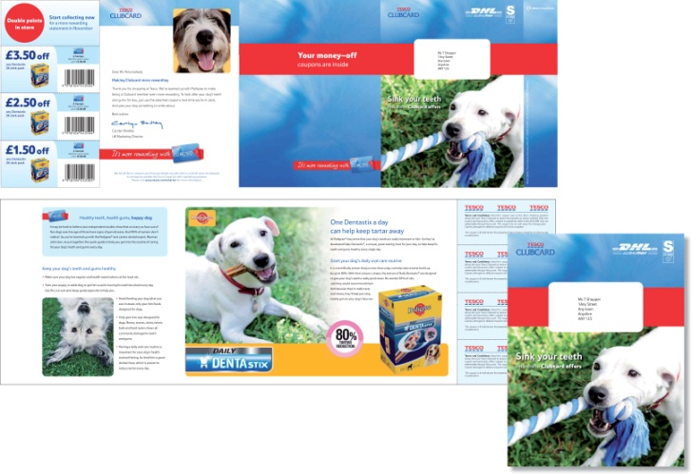
Customer Contact - Collaborative Mailings
A programme of Supplier and Commercial funded mailings from Clubcard
The mailings are designed to enhance the core Clubcard scheme
Used to reward and retain loyal and opportunity customers
Allows us to contact customers with high value, highly targeted relevant mailings
Adhere to strict guidelines to ensure that our customers understand that these mailings are from Tesco and not from the brands contained within them
Range of formats from a one piece mailer with coupons to a box enclosing a sample
The mailings also generate incremental uplift at little or no cost to Tesco
Used to achieve a variety of objectives:
Brand building
NPD launch support
Niche product support
Range change support
Drive frequency of purchase
Trade customers up

Slide 15
Clubcard Communication team
Lead the creative and campaign management processes in the Clubcard team. This includes:
Putting Clubcard at the heart of the business
By aligning Clubcard with the business trading plan
By creating campaigns to link statement vouchers to ways to spend them
Simply and powerfully communicating the mechanics and benefits of Clubcard in all our comms
Using consistent & straightforward explanations of how the scheme works mechanically, esp. double points
By powerfully demonstrating what Clubcard can save you on your shopping
Engaging, persuasive demonstrations of the x4 value with partners
Making Clubcard a vital part of our wider marketing communications
By having a TTL approach, with joined up briefs and creative executions
Developing and protecting the Clubcard brand
By delivering Clubcard Guidelines to help the business consistently talk about Clubcard
Using current and new technology as an important way to communicate to customers
e.g. phone apps, social & digital media, re-designing our website for increased usability
Getting strong PR for Clubcard
Ensuring the business and consumer press are interested and engaged in Clubcard
Using our staff as a media
By having bespoke Marketing for staff and turning them into our best ambassadors (e.g. free £5 double up token, staff Clubcard Millionaire, cakes in store for big launches)

Slide 16
Clubcard Technology – Customer Plan 2010/11
Current Clubcard technology lags behind our competitors, and through the customer plan will deliver new and exciting developments for customers. Currently:
It is a paper based scheme despite the development of online, email , text and e-coupons
It is only possible to update details etc by calling Dundee
It is not possible to join online unless you have picked up a temporary card in-store
The only account functionality on line is to view your points balance – this reflects the previous days balance
It runs on a main frame system that is not real time and is not capable of holding all the data for a digital Clubcard
As customers become more comfortable with new technology they are asking for some of these technologies to be applied to Clubcard in order to make Clubcard more convenient and relevant to their needs and lifestyle
Plans for development
Over the next 2 years we plan to develop a programme of investment in Customer facing technology and the operating systems infrastructure that is needed to allow customers to use existing Clubcard mechanics in more modern and convenient ways, and also deliver new functionality to improve the shopping trip

Slide 17
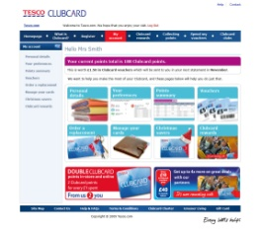
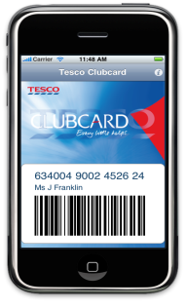

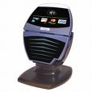
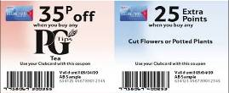
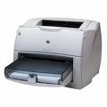

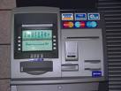
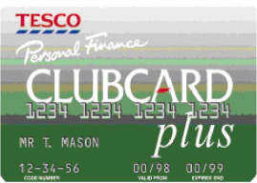
We have a clear plan to improve the customer technological experience
What Customers want to do
Technologies they could use
Join Clubcard and choose their Clubcard type
Standard
Mobile
Clubcard payment card
Administrate their account
Update personal details
Set preferences & permissions
Order & issue new cards & key fobs
Merge accounts/ add collectors
Participation & Engage in Clubcard
Points calculator
Information on points offers
See transaction history & points balances
See voucher history
Receive & store vouchers
Receive & store coupons
Receive & store Deals tokens
Checkout
Redeem coupons
Redeem & exchange vouchers
Redeem Deals tokens
Contactless
SMART & E-COUPONS

Slide 18
Clubcard Insight
Given the vast amount of money we invest in Clubcard each year, there is a real desire to ensure we fully maximise its benefit for both customers and Tesco
To do this we use a combination of Dunnhumby Analysis and Customer Research to produce comprehensive insight into the performance of the Clubcard Scheme
EXAMPLES OF THE ANALYSIS & RESEARCH WE PRODUCE
EXAMPLES OF HOW OUR INSIGHT IS SHARED
Understanding the value that the Clubcard Scheme delivers to our LFL growth – through Statement Voucher Redemptions, Clubcard Bonus, Trade Driver Mailings etc.
How to optimise the way in which we deliver reward to our customers
The true value of Clubcard Rewards (Deals)
Customer Focus Group Research on the value of Double Points
Customer Feedback on Clubcard using Every Comment Helps
A newly developed Clubcard Spotlight – that combines all our insight and KPIs from the latest period – to be shared with the business soon
A weekly Clubcard Trade Report
Dunnhumby reporting
Through 1-1s and team meetings
Ad hoc reporting to relevant areas across the business, e.g. double up reporting to all categories involved

Slide 19
Clubcard is at the centre of the business and therefore needs to work cross functionally
Working with Marketing
Trade Planning – keep the trade plan up to date with all Clubcard activity, plus ensure Clubcard are supporting the correct instore events/offers in our communication.
Local Marketing – prioritise stores which need support in our targeting hierarchy. Also ensure Local mailings are deduped against our Trade Drivers, to avoid over contacting or double discounting customers.
POS, Advertising, Publishing - communications team work with them to pull together joined up campaigns on Clubcard activity.
Insight – work with them to ensure forecasts and uplifts are reported to the business on a weekly basis.
Brand team – support ranges/brands through our communications, with coupons or imagery.
Working with the wider business
Commercial teams and Retail Services all encouraged to use coupons in our mailings.
We also support Commercial teams and Retail Services by promoting various products and offers in our mailing creative.
The Operations team work with Retail to improve staff and customer engagement with Clubcard.
Working with IT
Key in delivering each Clubcard Statement
Play a big part in future developments for the Clubcard scheme

